Slide 1
Hyper IgE syndrome

Slide 2
Classifications
Autosomal dominant
Autosomal recessive
STAT 3 mutation
Mutation in TYK2
Mutation in DOCK8
Unknown mutation
Notarangelo LD, et al. JACI 2009;124 : 1161-78

Slide 3
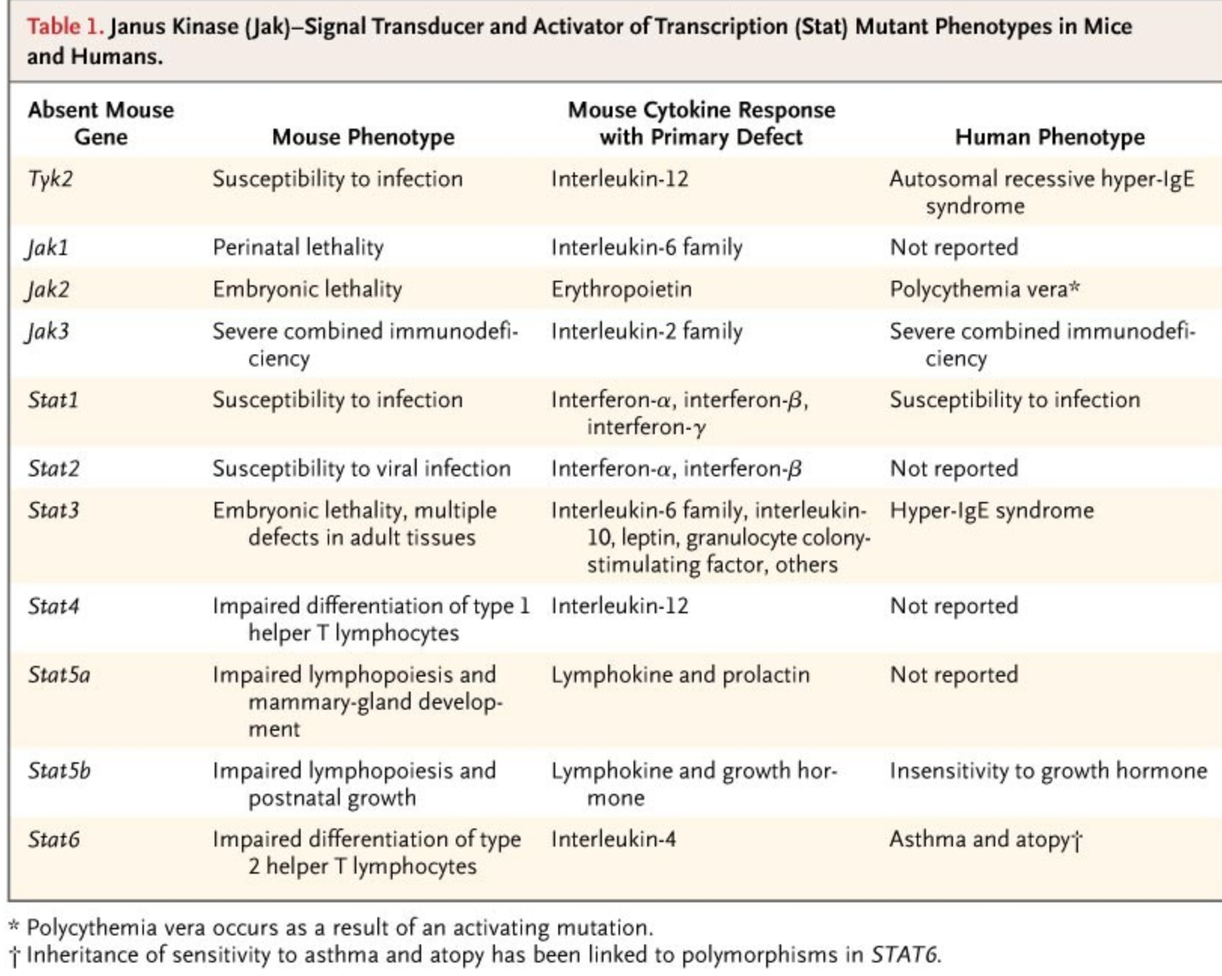

Slide 4
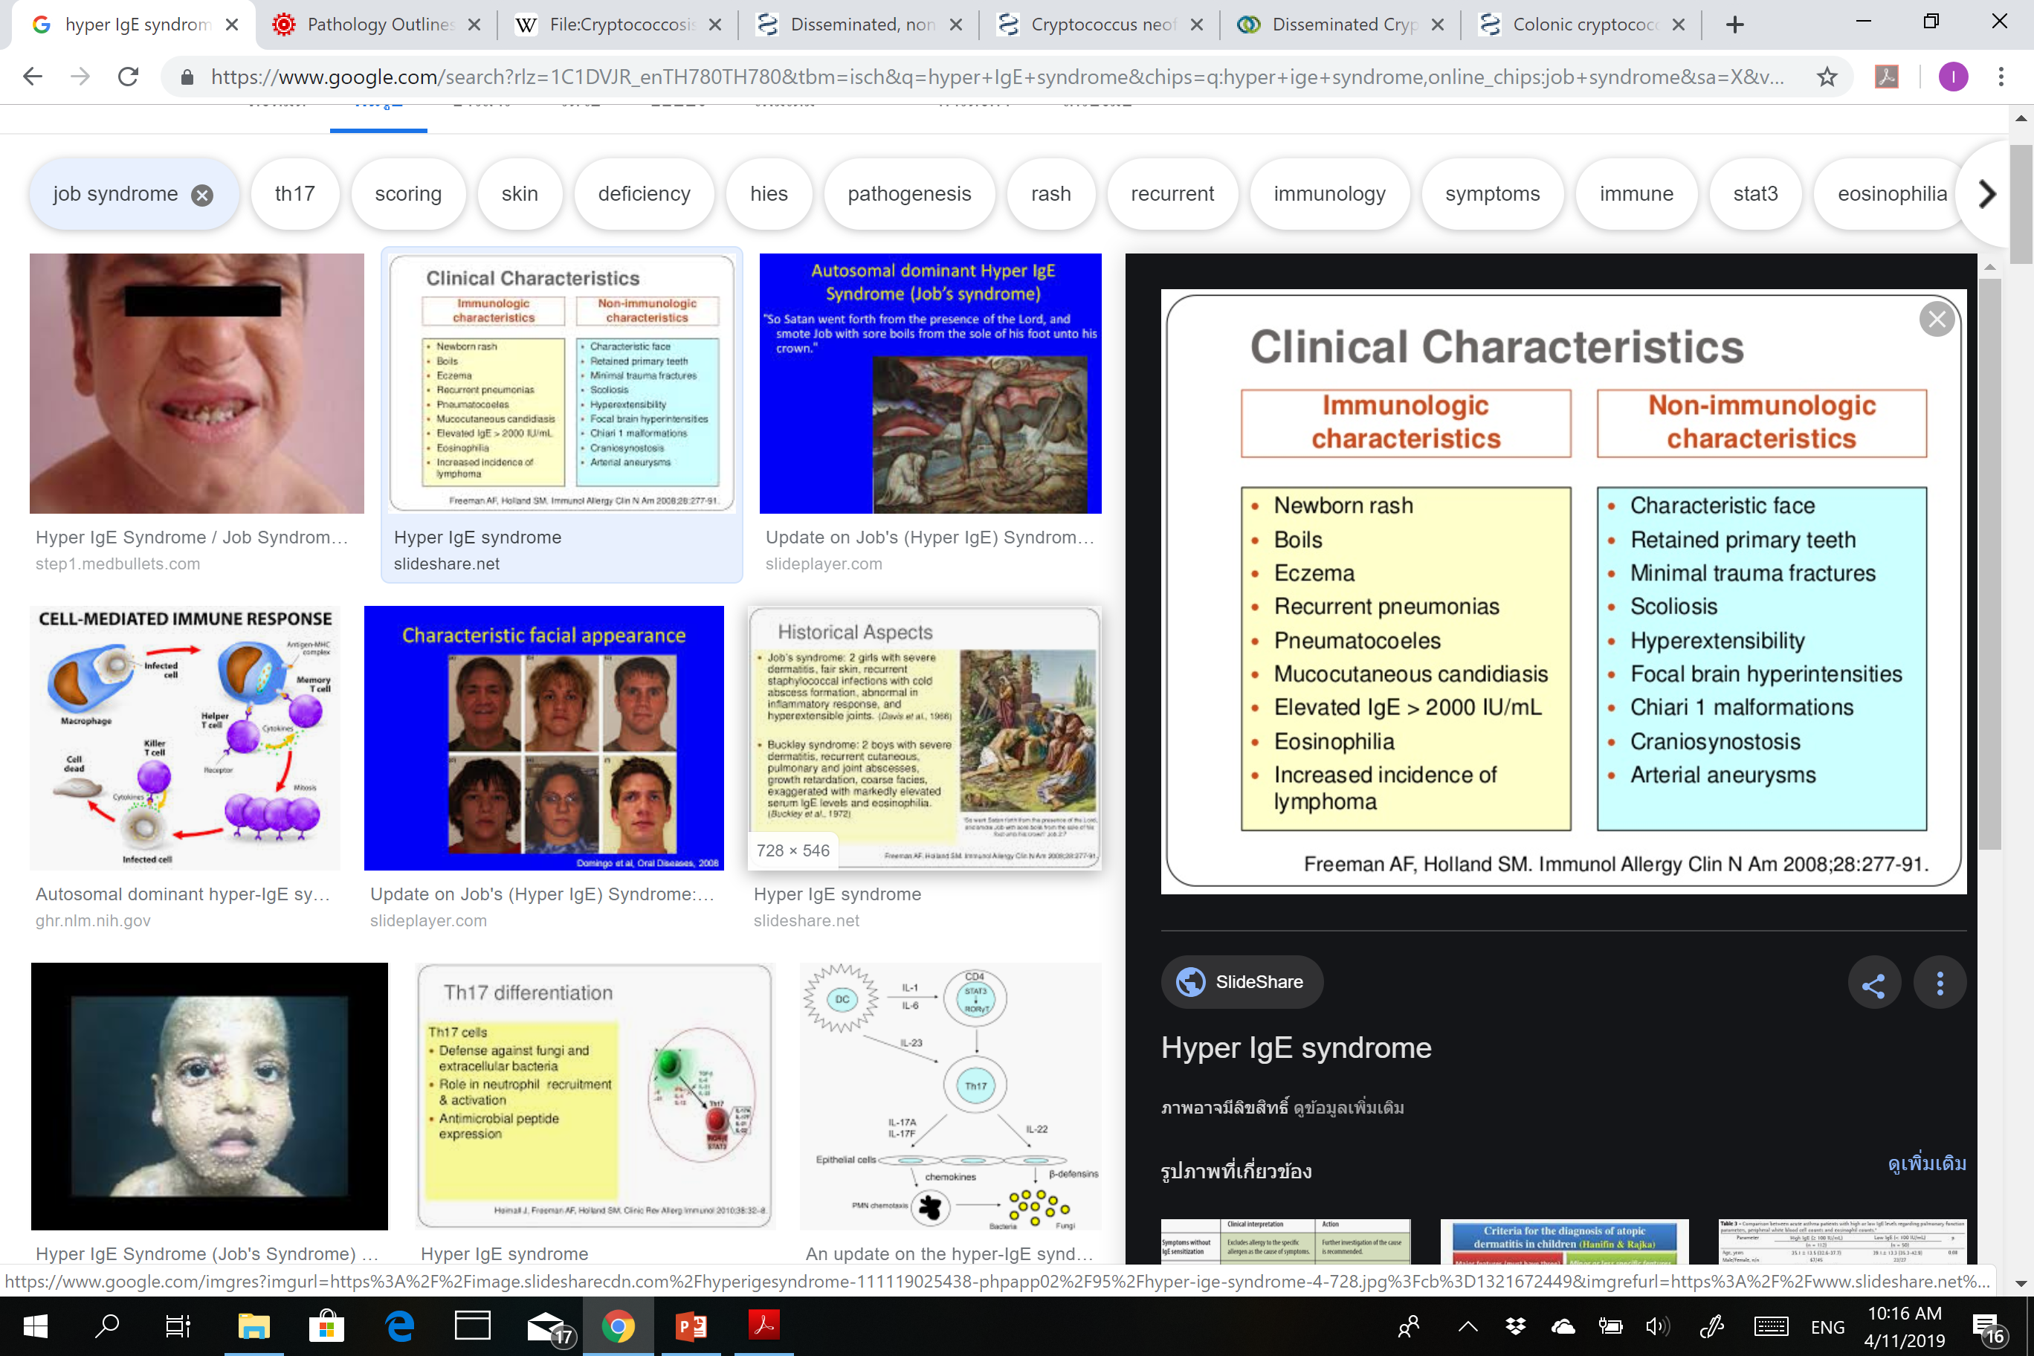
Immunological characteristics
Non-Immunological characteristics

Slide 5
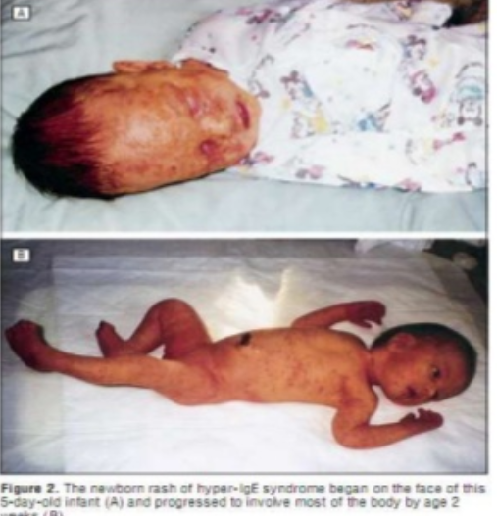
Newborn rash
Papulopustular eruption at scalp and face
> Neck, axillae, shoulder, arms, chest, diaper areas and buttocks

Slide 6
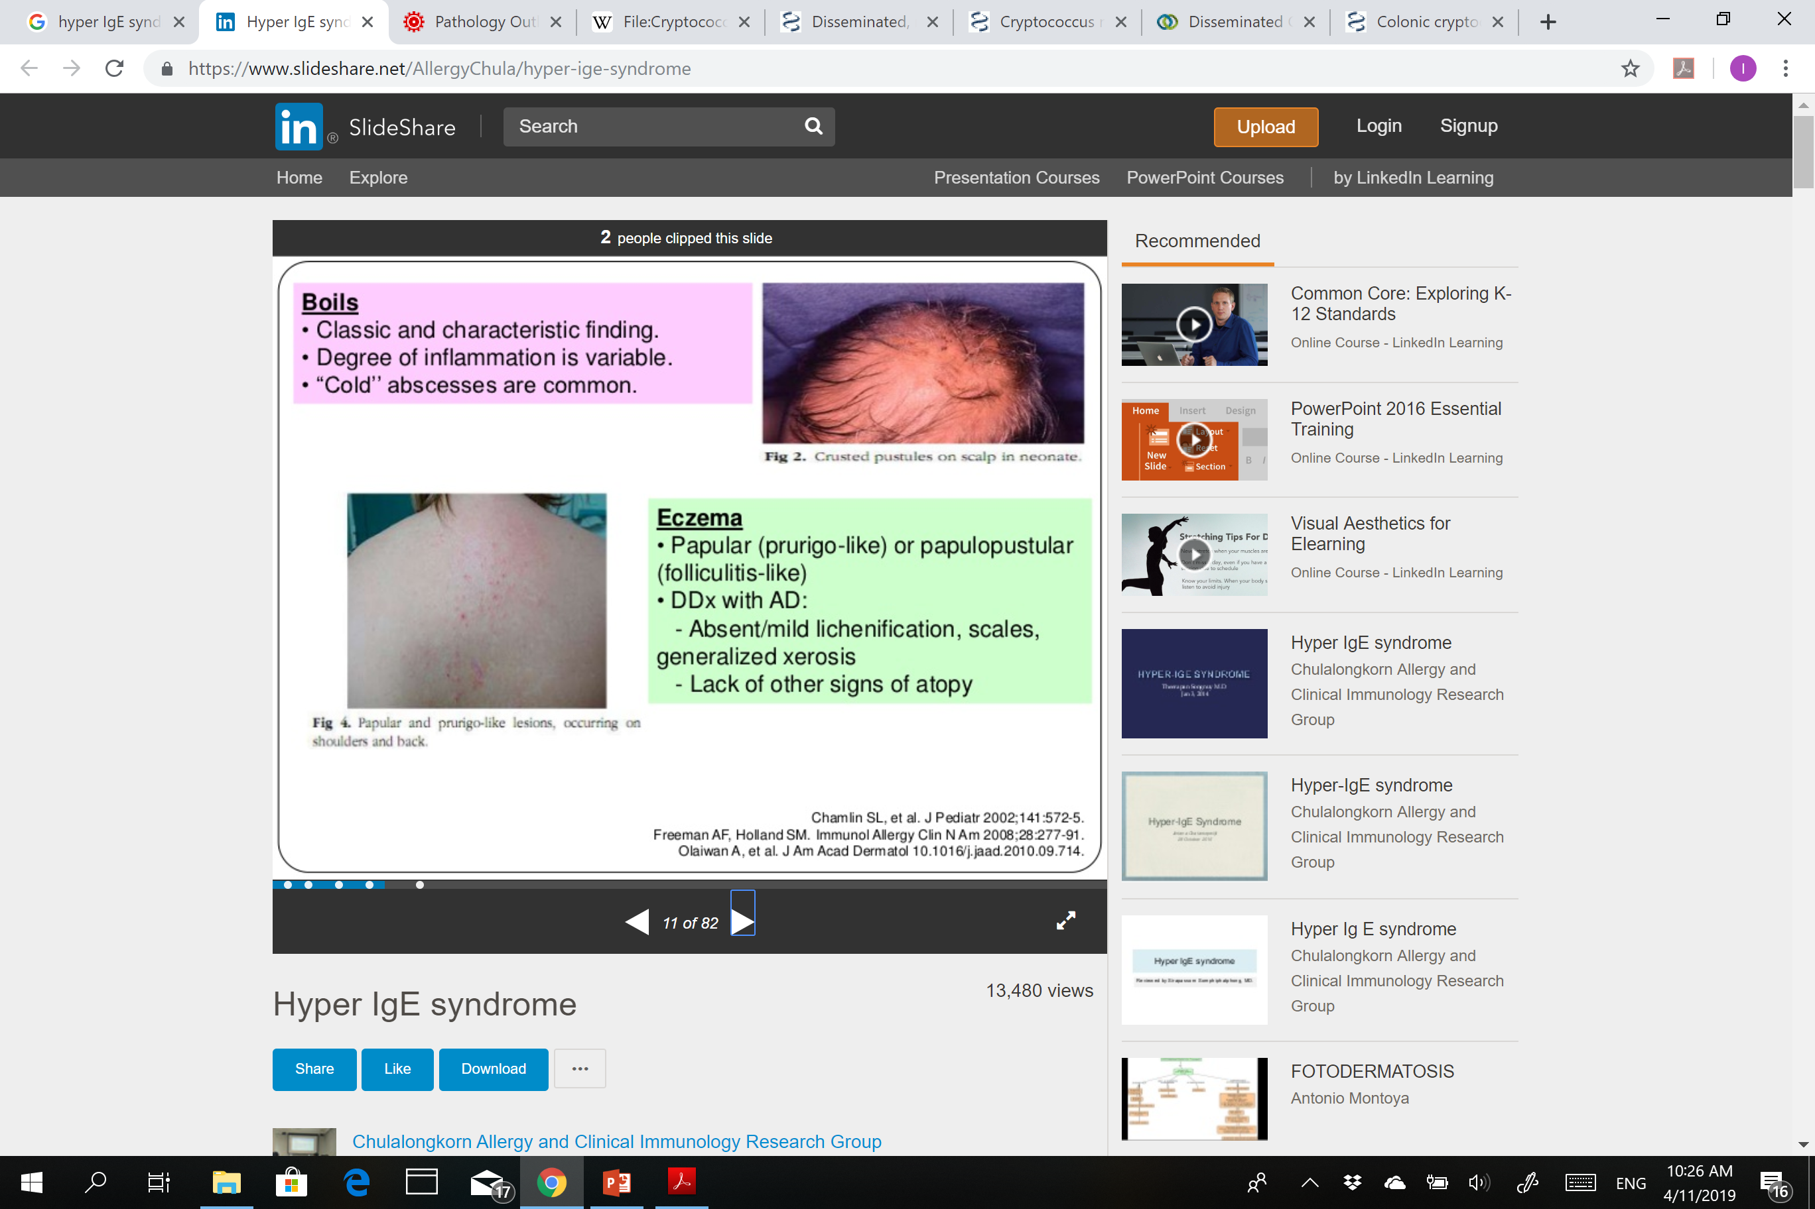
Boils
Eczema

Slide 7
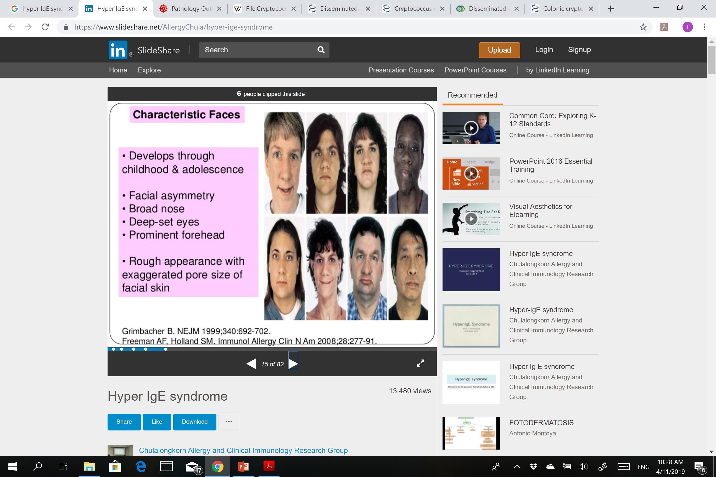

Characteristic faces

Slide 8
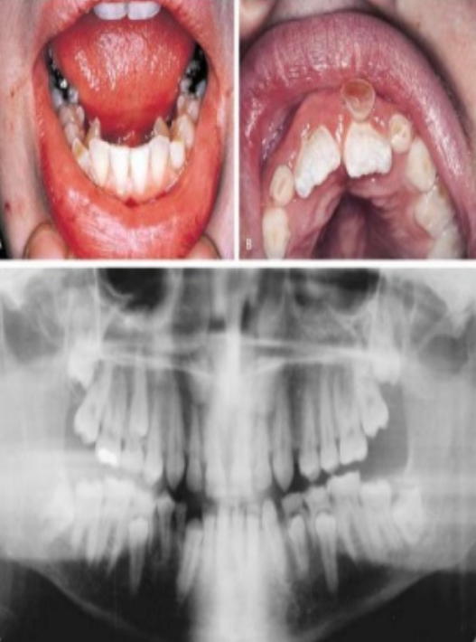

Dental anomalies

Slide 9
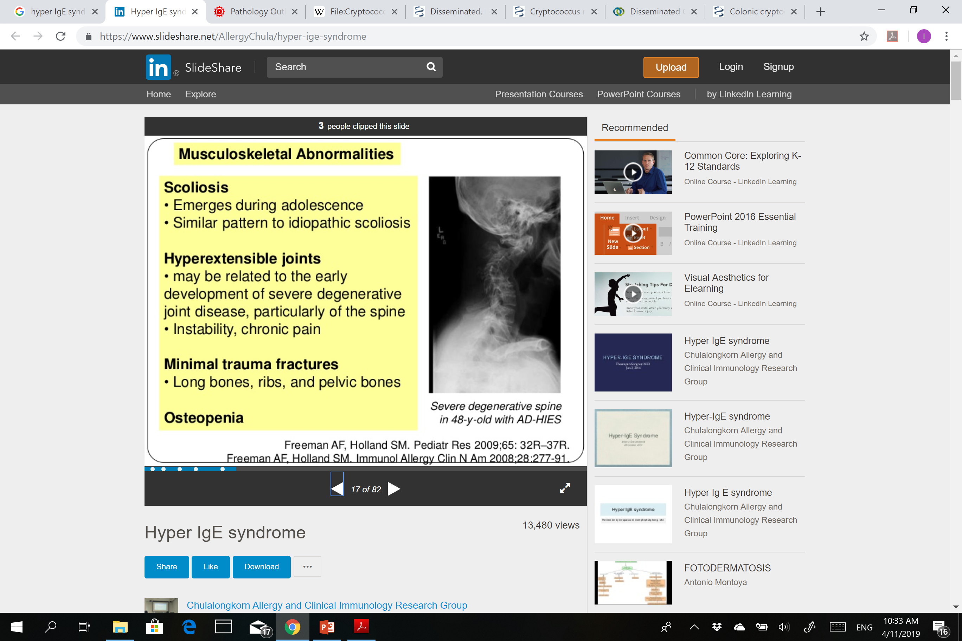
Musculoskeletal abnormalities

Slide 10
Other anomalies
Cranial : Chiari malformation, arachnoid cysts, craniosynostosis
Vascular : CRAO, artery aneurysms
Malignancy :
  Increase risk of malignancy
  HL and NHL (aggressive B cells)
  Leukemia
  CA of vulva, lung, liver

Slide 11
Treatments
Treatment of infection
IVIG
Omalizumab
Bone marrow transplantation
Bisphosphonates : fractures
Levamisole : Inferior to placebo
Topical corticosteroids : for skin eczema
Freeman AF, Holland SM. Immunol AllergyCLin N Am 2008;28 : 277-91
Su HC. Curr Opin Allergy Clin Immunol 2010 : 515-20

