Slide 1
Clinical pathological conference
11/4/2562

Slide 2
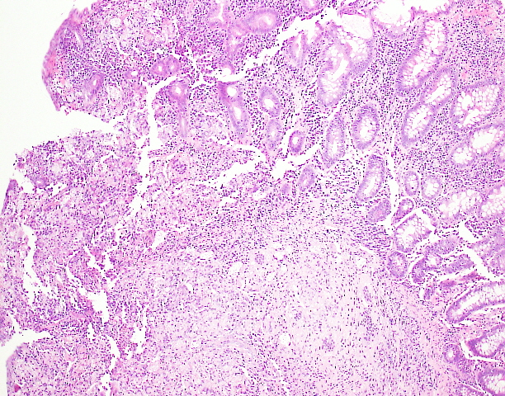
Notes:
Lymphocyte, plasma cells, epitheloid histiocytes infiltrate
Some neutrophils and eosinophils

Slide 3
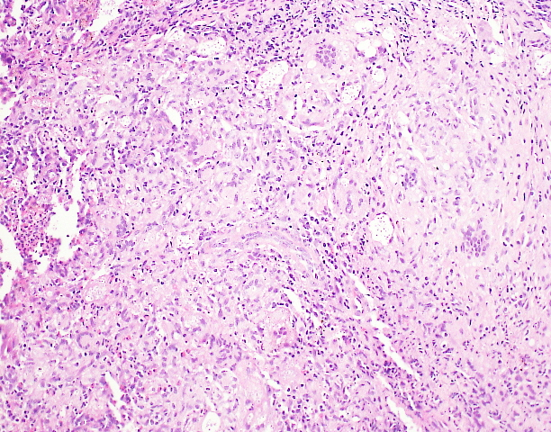
v
Notes:
Granuloma

Slide 4
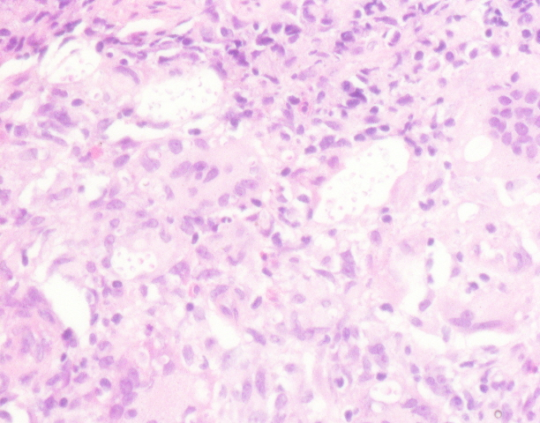
Notes:
Abundant small round yeast liked microorganism in infiltrating histiocytes : morphologically compatible with cryptococcosis

Slide 5
Ulcer at Illeocecal valve
Ulcer with perforation with granulomatous reaction of cryptococcus infection
Notes:
Negative for TB : PCR for TB

Slide 6
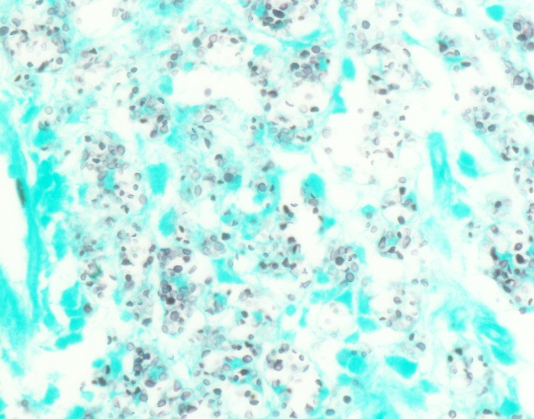
GMS stain
Notes:
GMS stain > confirmed cryptococcosis

Slide 7
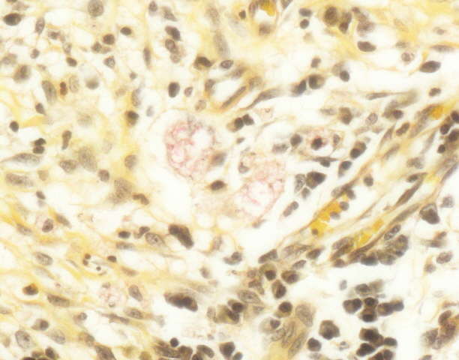
Mucicarmine stain
Notes:
Mucicarmine stain : ย้อม mucin > cryptococcal wall ติดเป็นสีชมพู

Slide 8
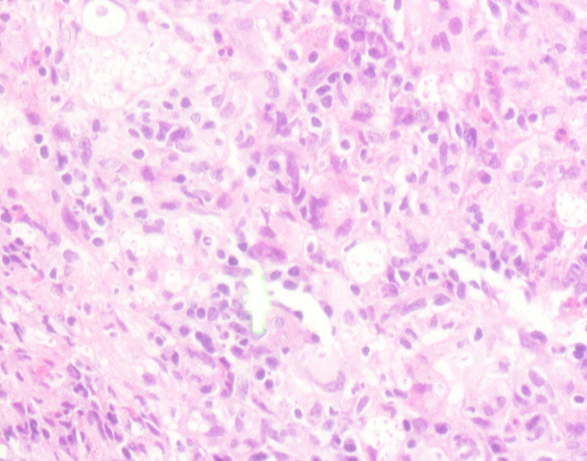
Notes:
CMV viral inclusion

Slide 9
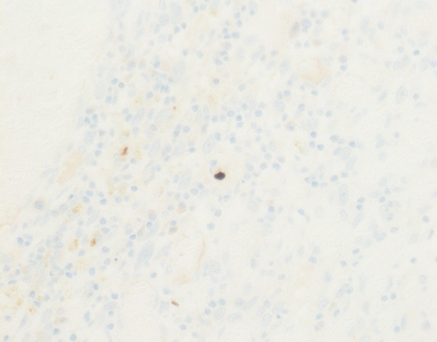
Notes:
Immunohistochemistry for CMV

Slide 10
3 pieces of colonic tissues with ulcers
The ulcer is infiltrated by lymphocytes, plasma cells, epitheloid histiocytes, some eosinophils and neutrophils. Multinucleated giant cells are also present.
There are abundant small round yeast liked organism in the infiltrating histiocytes. Viral cytopathic cells, comprising intranuclear and intracytoplasmic inclusions are occasionally seen.

Slide 11
Pathological diagnosis
Granulomatous inflammation with ulcer
Presence of CMV viral inclusion
Presence of fungus, morphologically compatible with cryptococcosis

Slide 12
Clinical progression

Slide 13
3 mo PTA Chronic diarrhea with abdominal pain
Colonoscopic Diagnosis :
CMV + Cryptococcal colitis
3 mo after admission :
Presented with Ileal perforartion from Cryptococcus Gatti infection
Tx :
-Amphotericin B total 3 weeks > Switch to Fluconazole
-Ganciclovir total 3 weeks > Switch to Valganciclovir
Tx :
-Explore lap with small bowel resection (Ileal 30 cm, intact IC valve)
-Amphotericin B total 3 weeks > Switch to Fluconazole
-Ganciclovir total 3 weeks > Switch to Valganciclovir

Slide 14
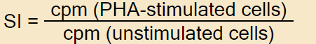
Work up : immune status
Anti HIV : negative
ANA : negative
Anti IFN Gamma : negative
WBC count : 7,010, Lymphocyte : 1,907
Normal CD3,CD4,CD8,CD19,CD56 counts
SPEP : polyclonal gammopathy
Normal total IgG,IgM,IgA level
Mild elevated IgG1, IgG2, IgG4
Total IgE level : 12,300 (< 100 IU/mL)
PHA Stimulation test : SI = 27, control = 76

Slide 15
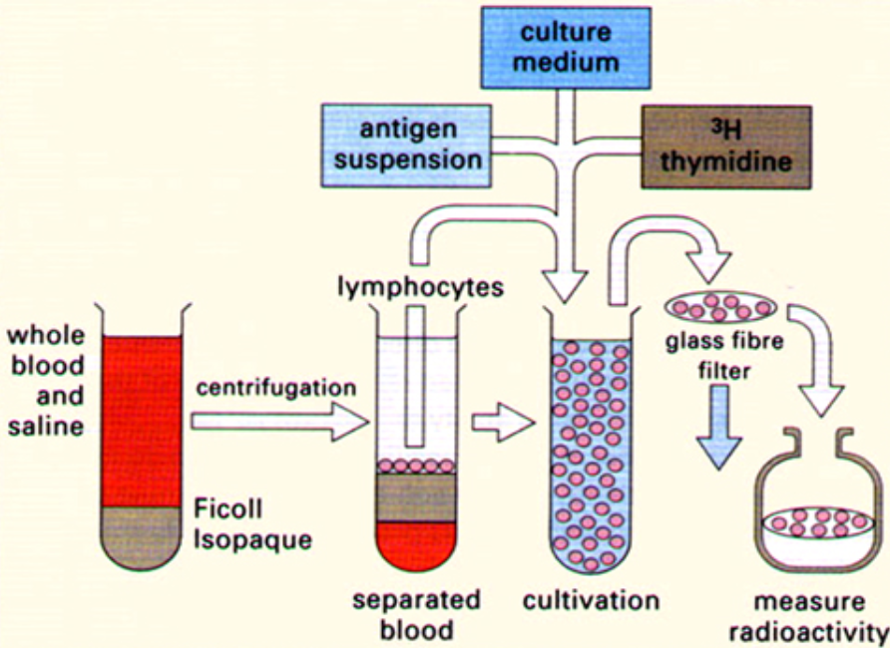

Slide 16
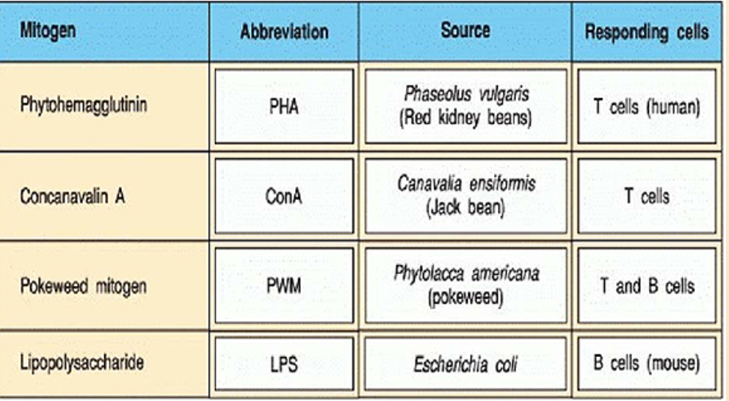

Slide 17
Work up : genetic of hyperIgE syndrome
STAT3 : mutation at p.R423Q
DOCK8
TYK2
SPINK5
PGM3

